Slide 1

IMPLEMENTAREA CONCURENTEI IN LIMBAJE DE PROGRAMARE
Ioana Leustean
INTRODUCERE IN
ERLANG
http://www.erlang.org/

Slide 2
Bibliografie
Joe Armstrong, Programming Erlang, Second Edition 2013
Fred Hébert, Learn You Some Erlang For Great Good, 2013
Varianta online

Slide 3
PARALELISM CONCURENTA SISTEME DISTRIBUITE
"Erlang was designed from the bottom up to program concurrent, distributed,
fault-tolerant, scalable, soft, real-time systems. […]
If your problem is concurrent, if you are building a multiuser system, or if
you are building a system that evolves with time, then using Erlang might
save you a lot of work, since Erlang was explicitly designed for building such
systems. […]
Processes interact by one method, and one method only, by exchanging
messages. Processes share no data with other processes. This is the reason
why we can easily distribute Erlang programs over multicores or networks. "
Joe Armstrong, Programming Erlang, Second Edition 2013

Slide 4

ACTOR MODEL
"Erlang's actor model can be imagined as a world where everyone is sitting alone in their own room and can perform a few distinct tasks. Everyone communicates strictly by writing letters and that's it. While it sounds like a boring life (and a new age for the postal service), it means you can ask many people to perform very specific tasks for you, and none of them will ever do something wrong or make mistakes which will have repercussions on the work of others; they may not even know the existence of people other than you (and that's great).
To escape this analogy, Erlang forces you to write actors (processes) that will share no information with other bits of code unless they pass messages to each other. Every communication is explicit, traceable and safe."
Varianta online
Fred Hébert, Learn You Some Erlang For Great Good
http://learnyousomeerlang.com/introduction#what-is-erlang

Slide 5
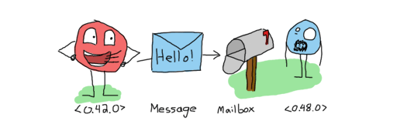
Transmiterea mesajelor este asincrona.
Datorita cozii pentru mesaje,
procesul care transmite mesajul
nu asteapta o confirmare de primire sau
prelucrarea acestuia,
mesajul intra in coada si asteapta
pana cand va fi procesat
http://learnyousomeerlang.com/the-hitchhikers-guide-to-concurrency#dont-panic

Slide 6
Modelul Actori
Introdus de Carl Hewitt in 1973
Actorii sunt o notiune abstracta (corespunzatoare proceselor)
Actorii au memorie proprie, NU au memorie partajata
Actorii comunica prin mesaje
Un actor este capabil sa:
trimita mesaje actorilor pe care ii cunoaste
creeze noi actori
raspunda mesajelor pe care le primeste
Mesajele contin un destinatar si un continut
Trimiterea mesajelor este asincrona

Slide 7
Concurenta in Erlang este implementata folosind urmatoarele primitive:
Pid = spawn (fun)
Pid = spawn (module, fct, args)
Pid ! Message
receive … end
https://www.erlang.org/doc/man/erlang.html#spawn-4

Slide 8
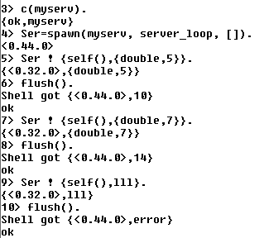
Cilent-Server (Exemplu simplu: doubling service)
Procesul Ser este serverul si
executa functia server_loop
Serverul primeste mesaje de la procese client si executa o actiune (dubleaza valoarea primita)
In acest exemplu singurul client este shell-ul
Mesajele primite de shell, adica raspunsurile trimise de server, sunt vizualizate cu flush()

Slide 9
Cilent-Server (Exemplu simplu: doubling service)
-module(myserv).
-export([server_loop/0]).
server_loop() ->
receive
{From, {double, Number}} -> From ! {self(),Number*2},
server_loop() ;
{From,_} -> From ! {self(),error},
server_loop()
end.

Slide 10
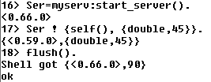
Cilent-Server : functie pentru pornirea server-ului
-module(myserv).
-export([server_loop/0]).
server_loop() ->
receive
{From, {double, Number}} -> From ! {self(), Number*2},
server_loop() ;
{From,_} -> From ! {self(),error},
server_loop()
end.
-export([start_server/0, server_loop/0]).
start_server() -> spawn(myserv, server_loop, []).

Slide 11
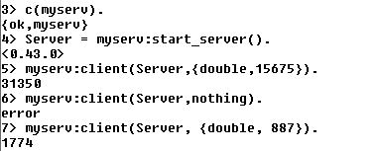
Cilent-Server: functia client
client(Pid, Request) ->
Pid ! {self(), Request},
receive
{Pid, Response} -> Response
end.
-module(myserv).
-export([start_server/0, server_loop/0,client/2]).
start_server() -> spawn(myserv, server_loop, []).
server_loop() ->
receive
{From, {double, Number}} -> From ! {self(),(Number*2)},
server_loop() ;
{From,_} -> From ! {self(),error},
server_loop()
end.
functia client intoarce raspunsul primit de la server
apelarea functiei client

Slide 12
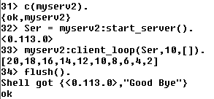
Client-Server
client_loop creaza mai multe procese client si intoarce lista rezultatelor
client_loop(Pid,0,L) -> Pid! {self(),"Good Bye"},
L;
client_loop(Pid, X, L) -> R= client(Pid,{double,X}),
client_loop(Pid, X-1, L++[R]).

Slide 13
Client-Server
client_loop creaza mai multe procese client si intoarce lista rezultatelor
client_loop(Pid,0,L) -> Pid! {self(),"Good Bye"},
L;
client_loop(Pid, X, L) -> R= client(Pid,{double,X}),
client_loop(Pid, X-1, L++[R]).
procesele client se executa secvential

Slide 14
Client-Server
client_loop creaza mai multi clienti si intoarce lista rezultatelor
client_loop(Pid,0,L) -> Pid! {self(),"Good Bye"},
L;
client_loop(Pid, X, L) -> R= client(Pid,{double,X}),
io:fwrite("prel ~w!~n", [N]),
client_loop(Pid, X-1, L++[R]).
Functiile client sunt executate secvential!

Slide 15
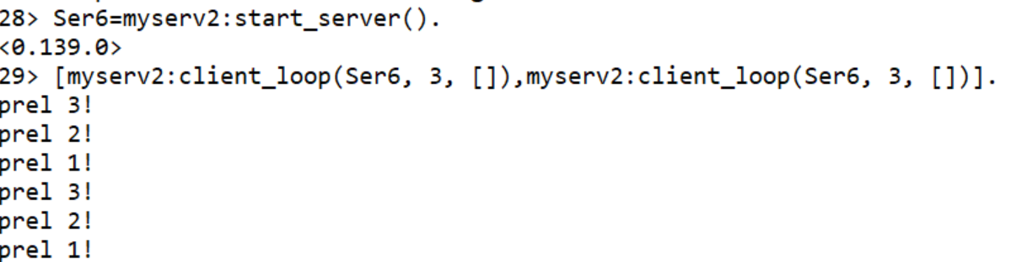
Client-Server
client_loop creaza mai multi clienti si intoarce lista rezultatelor
client_loop(Pid,0,L) -> Pid! {self(),"Good Bye"},
L;
client_loop(Pid, X, L) -> R= client(Pid,{double,X}),
io:fwrite("prel ~w!~n", [N]),
client_loop(Pid, X-1, L++[R]).
Functiile client sunt executate secvential!

Slide 16
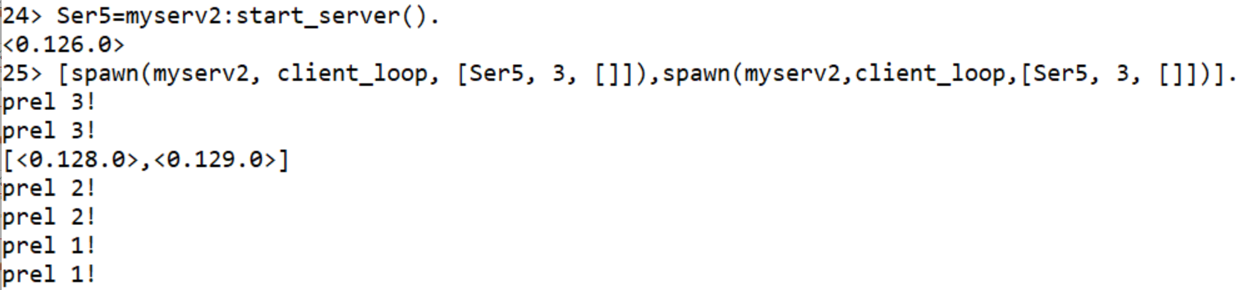
Client-Server
client_loop creaza mai multi clienti si intoarce lista rezultatelor
client_loop(Pid,0,L) -> Pid! {self(),"Good Bye"},
L;
client_loop(Pid, X, L) -> R= client(Pid,{double,X}),
io:fwrite("prel ~w!~n", [N]), client_loop(Pid, X-1, L++[R]).
Functiile client sunt executate in paralel!

Slide 17
Client-Server
procesele client se executa in paralel
si se intoarce lista rezultatelor
worker(Parent, Pid, Number) -> spawn( fun() ->
Result = client (Pid,{double,Number}),
Parent ! {self(),Result}
end ).
calls (Pid,N) -> Parent = self(),
Pids = [worker(Parent,Pid, X) || X <- lists:seq(1,N)],
[ wait_one(P) || P <- Pids ].
wait_one (Pid) ->
receive
{Pid,Response} -> Response
end.
% Pid este id-ul procesului server
% Parent este id-ul procesului care creaza clientii
% worker creaza un proces client si intoarce id-ul acestuia

Slide 18
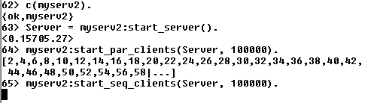
Client-Server
start_server() -> spawn(myserv, server_loop, []).
start_seq_clients(Pid, N) -> client_loop(Pid,N,[]).
start_par_clients(Pid, N) -> calls(Pid,N).

Slide 19
Client-Server
unui proces i se poate asocia un nume (atom) folosind register
myserv3.erl
start_server() -> register(serv, spawn(fun() ->server_loop() end)).
server_loop() ->
receive
{From, {double, Number}} -> From ! {serv,(Number*2)},
server_loop() ;
{From, "Good Bye"} -> From! {serv,"Good Bye"},
server_loop();
{From,_} -> From ! {serv,error},
server_loop()
end.
procesul server are numele serv

Slide 20
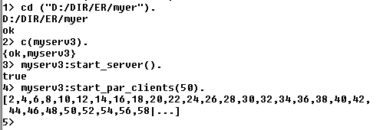
Client-Server
start_par_clients(N) -> calls(N).
worker(Parent, Number) ->
spawn( fun() ->
Result = client ({double,Number}),
Parent ! {self(),Result}
end ).
calls (N) ->
Parent = self(),
Pids = [worker(Parent,X)|| X <- lists:seq(1,N)],
[waitone(P)|| P <- Pids].
waitone (Pid) ->
receive
{Pid,Response} -> Response
end.
client(Request) ->
serv ! {self(), Request},
receive
{serv, Response} -> Response
end.

Slide 21
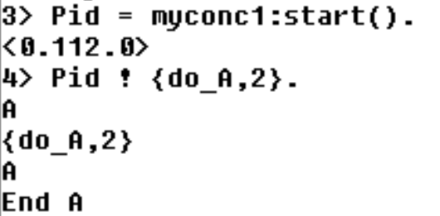
?MODULE
macro care intoarce numele modulului curent
start() -> spawn(?MODULE, myrec, []).
myrec() ->
receive
{do_A, X} -> prelA(X);
{do_B, X} -> prelB(X);
_ -> io:format("Nothing to do ~n")
end.

Slide 22
Cilent-Server (simple) template
-module(servtemplate2).
-compile(export_all).
start_server() ->
register(serv,spawn(?MODULE, server_loop, [])).
client(Request) ->
serv ! {self(), Request},
receive
{serv, Response} -> Response
end.
server_loop() ->
receive
…..
{From, Request} -> From ! {serv, Response} ,
server_loop()
end.
-module(servtemplate1).
-compile(export_all). %exporta toate functiile
start_server() -> spawn(?MODULE, server_loop, []).
client(Pid, Request) ->
Pid ! {self(), Request},
receive
{Pid, Response} -> Response
end.
server_loop() ->
receive
…..
{From, Request} -> From ! {self(),Response} ,
server_loop()
end.

Slide 23
Schimb de mesaje cu transmiterea starii
(message passing with data storage)
Procesul (serverul) este un frigider care accepta doua tipuri de comenzi
- depoziteaza alimente,
- scoate alimente .
Acelasi aliment poate fi depozitat de mai multe ori si
poate fi scos de cate ori a fost depozitat.
La fiecare moment trebuie sa stim ce alimente se gasesc in frigider
(starea procesului).
Starea procesului se transmite prin parametrii functiilor.
kitchen.erl
http://learnyousomeerlang.com/

Slide 24
Schimb de mesaje cu transmiterea starii
fridgef(FoodList) ->
receive
% comanda store
% comanda take
….
end.
store(Pid, Food) ->
Pid ! {self(), {store, Food}},
receive
{Pid, Msg} -> Msg
end.
take(Pid, Food) ->
Pid ! {self(), {take, Food}},
receive
{Pid, Msg} -> Msg
end.
kitchen.erl
http://learnyousomeerlang.com/

Slide 25
Mesaje cu transmiterea starii
kitchen.erl
http://learnyousomeerlang.com/
fridgef(FoodList) ->
receive
{From, {store, Food}} -> From ! {self(), ok}, fridgef([Food|FoodList]);
{From, {take, Food}} -> case lists:member(Food, FoodList) of true -> From ! {self(), {ok, Food}},
fridgef(lists:delete(Food, FoodList)); false -> From ! {self(), not_found}, fridgef(FoodList)
end;
terminate -> ok
end.

Slide 26
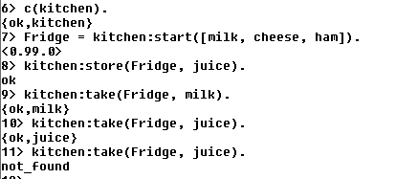

Slide 27
Varianta: registered process, comenzile show (pentru a vizualiza starea) si terminate
start(FoodList) -> register(fridge, spawn(fun()-> fridgef(FoodList) end)).
show() ->
fridge ! {self(), show},
receive
{fridge, Msg} -> Msg
end.
terminate() ->
fridge ! {self(), terminate},
receive
{fridge, Msg} -> Msg
end.
store(Food) ->
fridge! {self(), {store, Food}},
receive
{fridge, Msg} -> Msg
end.
take( Food) ->
fridge ! {self(), {take, Food}},
receive
{fridge, Msg} -> Msg
end.

Slide 28
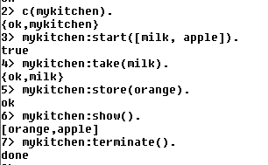
Varianta: registered process, comenzile show (pentru a vizualiza starea) si terminate
fridgef(FoodList) ->
receive
{From, {store, Food}} -> From ! {fridge, ok},
fridgef([Food|FoodList]);
{From, {take, Food}} ->
case lists:member(Food, FoodList) of
true -> From ! {fridge, {ok, Food}},
fridgef(lists:delete(Food, FoodList));
false -> From ! {fridge, not_found},
fridgef(FoodList)
end;
{From,show} -> From ! {fridge, FoodList},
fridgef(FoodList);
{From,terminate} -> From ! {fridge, done}
end.
mykitchen.erl

Slide 29
receive … after … end
procesul asteapta pana cand primeste un mesaj care se potriveste cu un pattern sau pana cand expira timpul .
timpul T este exprimat in milisecunde
procesul va astepta maxim T milisecunde sa primeasca un mesaj
daca nici un mesaj care se potriveste cu un patern nu este primit in timpul T, procesul executa ExpressionT
receive
Pattern1 when Guard1 -> Expr1;
Pattern2 when Guard2 -> Expr2;
Pattern3 -> Expr3
…
after T ->
ExpressionT
end

Slide 30
receive … after … end
flush() ->
receive
_ -> flush()
after 0 ->
ok
end.
sleep(T) ->
receive
after T ->
ok
end.
nu exista sabloane, deci niciun mesaj
nu va fi acceptat;
procesul va fi blocat T milisecunde
orice mesaj se potriveste cu patternul, deci
apelul recursiv va goli coada de mesaje, dupa
care procesul va continua
instructiunea
after 0 -> …
verifica coada de mesaje si apoi continua;
daca aceasta clauza lipseste, procesul se va bloca
cand coada de mesaje se goleste

Slide 31
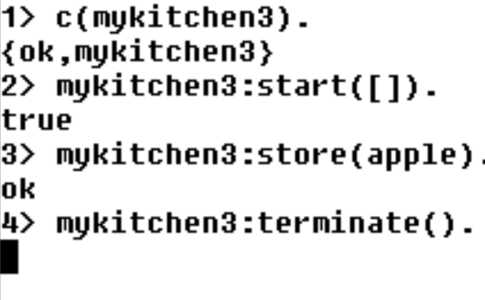
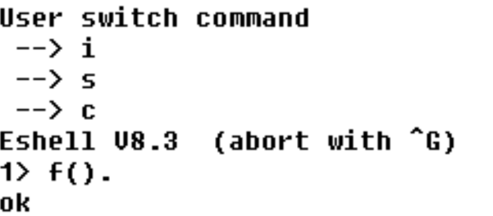
mykitchen3.erl
fridgef(FoodList) ->
receive
{From, {store, Food}} -> From ! {fridge, ok},
fridgef([Food|FoodList]);
{From, {take, Food}} ->
case lists:member(Food, FoodList) of
true -> From ! {fridge, {ok, Food}},
fridgef(lists:delete(Food, FoodList));
false -> From ! {fridge, not_found},
fridgef(FoodList)
end;
{From,show} -> From ! {fridge, FoodList},
fridgef(FoodList)
end,
io:format("al doilea receive~n"),
receive
{From,terminate} -> From ! {fridge, done}
end.
procesul este blocat
pentru ca nu poate iesi din
primul receive
Ctrl-G deblocheaza shell-ul
f() dezleaga variabilele
http://erlang/doc/man/shell.html

Slide 32
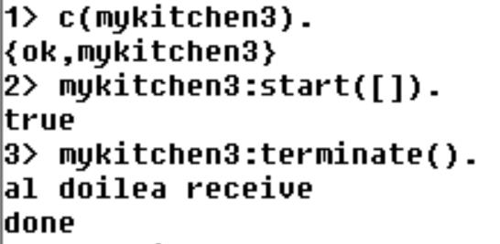
receive … after … end
fridgef(FoodList) ->
receive
{From, {store, Food}} -> From ! {fridge, ok},
fridgef([Food|FoodList]);
{From, {take, Food}} ->
case lists:member(Food, FoodList) of
true -> From ! {fridge, {ok, Food}},
fridgef(lists:delete(Food, FoodList));
false -> From ! {fridge, not_found},
fridgef(FoodList)
end;
{From,show} -> From ! {fridge, FoodList},
fridgef(FoodList)
after 30000 -> timeout
end,
io:format("al doilea receive~n"),
receive
{From,terminate} -> From ! {fridge, done}
end.
dupa 30 sec
in apelul terminate(), procesul shell asteapta
mesaj de la fridge pentru receive din terminate()
apelul functiei terminate() se incheie numai dupa
ce trec cele 30 sec si poate fi prelucrat mesajul
"terminate" in al doilea receive din fridgef()
terminate() ->
fridge ! {self(), terminate},
receive
{fridge, Msg} -> Msg
end.

Slide 33
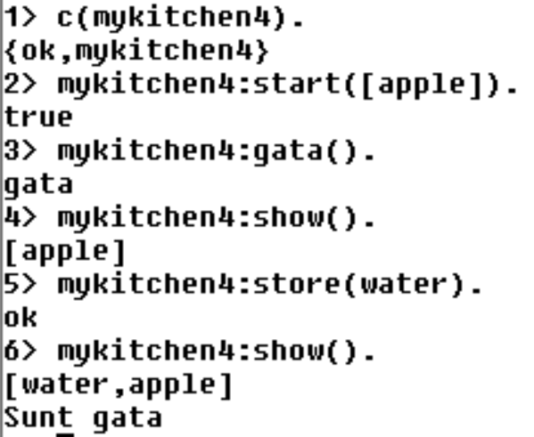
receive … after … end
fridgef(FoodList) ->
receive
{From, {store, Food}} -> From ! {fridge, ok},
fridgef([Food|FoodList]);
{From, {take, Food}} ->
case lists:member(Food, FoodList) of
true -> From ! {fridge, {ok, Food}},
fridgef(lists:delete(Food, FoodList));
false -> From ! {fridge, not_found},
fridgef(FoodList)
end;
{From,show} -> From ! {fridge, FoodList},
fridgef(FoodList);
{From,terminate} -> From ! {fridge, done}
after 30000 -> timeout
end,
receive
gata -> io:format("Sunt gata~n")
end.
functia gata() intoarce imediat,
shell-ul nu ramane blocat
se pot trimite mesaje serverului
mesajul gata este prelucrat dupa ce au trec 30 sec
fara o comanda prelucrata de primul receive
gata() -> fridge ! gata

Slide 34
receive … after … end
La intrarea in receive, daca exista un after, se porneste un timer.
Mesajele din coada sunt investigate in ordinea sosirii; daca un mesaj se potriveste cu un pattern atunci expresia corespunzatoare este prelucrata.
Mesajele care nu se potrivesc cu nici un pattern sunt puse intr-o coada separate (save queue).
Daca nu mai sunt mesaje in coada procesul se suspenda si asteapta venirea unui nou mesaj; la venirea acestuia, numai el este prelucrat, nu si mesajele din save queue.
Cand un mesaj se potriveste cu un pattern, mesajele din save queue sunt puse la loc in coada si timerul se sterge.
Daca timpul T s-a scurs fara ca un mesaj sa se potriveasca unui pattern, atunci ExpressionT se executa, iar mesajele din save queue sunt puse inapoi in coada.
receive
Pattern1 when Guard1 -> Expr1;
Pattern2 when Guard2 -> Expr2;
Pattern3 -> Expr3
…
after T ->
ExpressionT
end

Slide 35
Selective receives
important() ->
receive
{Priority, X} when Priority > 10 -> [X|important()] after 0 ->
normal()
end.
normal() ->
receive
{_,X} ->
[X|normal()]
after 0 -> []
end.
flush() ->
receive
_ -> flush()
after 0 ->
ok
end.
Varianta a functiei flush() care
ordoneaza mesajele dupa prioritati

Slide 36
Concurenta in Erlang este implementata folosind urmatoarele primitive:
Pid = spawn (fun)
Pid = spawn (module, fct, args)
Pid ! Message
receive … end
receive … after … end

Slide 37
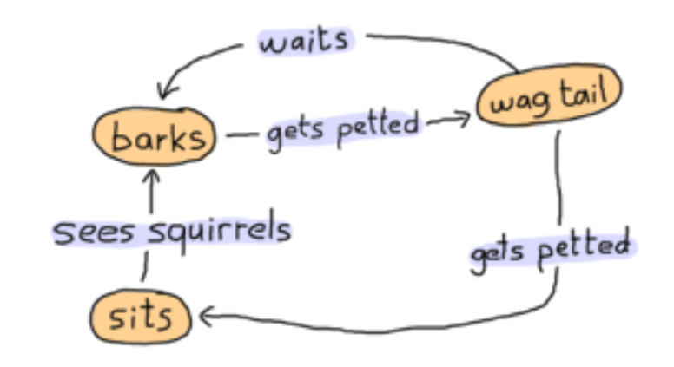
Implementarea unui automat finit
(Finite-State Machine)
Starile ={barks, sits, wag_tail}
Actiunile ={gets_petted, see_squirrels, waits}
dog as a state-machine
http://learnyousomeerlang.com/finite-state-machines#what-are-they

Slide 38

Implementarea unui automat finit
-module(dog_fsm).
-export([start/0, squirrel/1, pet/1]).
start() ->
spawn(fun() -> bark() end). % starea initiala
%actiunea see_squirrels
squirrel(Pid) -> Pid ! squirrel.
%actiunea gets_petted
pet(Pid) -> Pid ! pet.
actiunile sunt implementate prin mesaje si
sunt vizibile in exterior

Slide 39
Finite-StateMachine: implementarea starilor
bark() ->
io:format("Dog says: BARK! BARK!~n"),
receive
pet -> wag_tail();
_ -> io:format("Dog is confused~n"),
bark()
after 2000 -> bark()
end.

Slide 40
Automat finit: definirea starilor
wag_tail() ->
io:format("Dog wags its tail~n"),
receive
pet -> sit();
_ -> io:format("Dog is confused~n"),
wag_tail()
after 30000 ->
bark() % actiunea waits
end.

Slide 41
Automat finit: definirea starilor
sit() ->
io:format("Dog is sitting. Gooooood boy!~n"),
receive
squirrel -> bark();
_ -> io:format("Dog is confused~n"),
sit()
end.

Slide 42
Implementarea unui automat finit
http://learnyousomeerlang.com/finite-state-machines#what-are-they

Slide 43
Tratarea erorilor
Error handling in concurrent Erlang programs is based on the idea of remote
detection and handling of errors. Instead of handling an error in the process
where the error occurs, we let the process die and correct the error in some
other process."
Joe Armstrong, Programming Erlang, Second Edition 2013
OTP
OTP stands for Open Telecom Platform, although it's not that much about telecom anymore (it's more about software that has the property of telecom applications, but yeah.) If half of Erlang's greatness comes from its concurrency and distribution and the other half comes from its error handling capabilities, then the OTP framework is the third half of it.
http://learnyousomeerlang.com/what-is-otp#its-the-open-telecom-platform

